Slide 1
Foundations of Complex Software Architectures and Styles
Damian A. Tamburri, Ph.D.
damianandrew.tamburri@polimi.it
dtamburri@acm.org

Slide 2
Where were we with DevOps?
I believe we were here:
➔ “...what are containers for, actually?”
Infrastructure-as-Code!
“A DevOps Tactic for accelerated, versionable, high-quality, highly-deployable cloud applications”

Slide 3
DevOps ➔ Hot topic for today!
Infrastructure-as-Code!
“A DevOps Tactic for accelerated, versionable, high-quality, highly-deployable cloud applications”
…
Continuous Architecting!
“A DevOps Architectural Tactic to structure architectures for them to be DevOps-Ready”

Slide 4
But first...
Let’s start from the beginning...

Slide 5
Why Social Software Engineering? Top failure causes so far*
Unrealistic deadlines, e.g., imposed by someone external to the technical staff
Requirements & people change (too) often
Effort and resources have been estimated in an overly optimistic way,
Risks have not been taken into account from the start of the project.
Risks can be technical or human difficulties
Communication problems among staff members
Difficulty by the management to recognize recurrent delays and take immediate action
Subversive stakeholders
*Gartner Report 2012 + Our Own SLR

Slide 6
Why Social Software Engineering? Top failure causes so far* An Example?
Unrealistic deadlines, e.g., imposed by someone external to the technical staff
Requirements & people change (too) often
Effort and resources have been estimated in an overly optimistic way,
Risks have not been taken into account from the start of the project.
Risks can be technical or human difficulties
Communication problems among staff members
Difficulty by the management to recognize recurrent delays and take immediate action
Subversive stakeholders
*Gartner Report 2012 + Our Own SLR

Slide 7

Why Social Software Engineering? Top failure causes so far* An Example!
(UNFORESEEN) OVERHEAD COST: 174,000,000 $ (give or take)
http://www.cio.com/article/2380827/developer/6-software-development-lessons-from-healthcare-gov-s-failed-launch.html

Slide 8



What is DevOps?
“DevOps is a set of practices intended to reduce the time between committing a change to a system and the change being placed into normal production, while ensuring high quality.”
L. Bass et Al. [1]
Notes:
A series of practices, ie. Best practices that reduce time and friction between development and operations… seems fair, seems easy... Now I was struggling to turn this definition into a form that would make you grasp what devops is really about...

Slide 9
What is DevOps?
“DevOps is a set of practices intended to reduce the time between committing a change to a system and the change being placed into normal production, while ensuring high quality.”
L. Bass et Al. [1]
Infrastructure-as-code
Ops Shift-Left
…
Notes:
I could have started introducing you to the various practices (and there are many) that devops gurus claim to add velocity to software processes but actually… any practice is worthless in the hands of the unpracticed

Slide 10
What is DevOps?
“DevOps is a set of practices intended to reduce the time between committing a change to a system and the change being placed into normal production, while ensuring high quality.”
L. Bass et Al. [1]
Boring!
Infrastructure-as-code
Ops Shift-Left
…
Notes:
So I thought that this definition is kind of boring and it does not really reflect the true nature of DevOps

Slide 11

What is DevOps?
“DevOps is a set of practices intended to reduce the time between committing a change to a system and the change being placed into normal production, while ensuring high quality.”
L. Bass et Al. [1]
DevOps is about people and their organisation!
Boring!
Infrastructure-as-code
Ops Shift-Left
…
Notes:
And that true nature is about software and humans and how they relate together…

Slide 12

What is DevOps?
“DevOps means baking a cake with two sets of cooks, with two sets of cookbooks, with opposite tastes and without a kitchen.”
D. A. Tamburri
Notes:
So here’s a more human version of Len’s original definition… rather than practice-driven, my definition is problem-driven and much more human-savy if you will

Slide 13
What is DevOps?
“DevOps means baking a cake with two sets of cooks, with two sets of cookbooks, with opposite tastes and without a kitchen.”
4 Questions emerge:
…Cake?
…Cooks?
...Cookbooks?
...and, Kitchen?
Notes:
Now, if I caught your interest you may be wondering or you should be wondering four things…
what’s the cake? Personally I like the one with chocolate everywhere
Who are the cooks?
What about their cookbooks and lastly, how about that kitchen that this guy is so eager to explain to us... Well, first things first...

Slide 14
What is DevOps?
“DevOps means baking a cake with two sets of cooks, with two sets of cookbooks, with opposite tastes and without a kitchen.”
4 Questions emerge:
…Cake
…Cooks?
...Cookbooks?
...and, Kitchen?
Notes:
The cake!

Slide 15
First things first… Product?
Software == Product == Customer!
“DevOps means baking a cake with two sets of cooks, with two sets of cookbooks, with opposite tastes and without a kitchen.”
What is the cake? The product and the customer together!
Software needs the granularity to be malleable for customer-centric design (E.g., consider microservices);
Industry 4.0 – the customer is his own software factory;
IoT...;
CPS...;
“I want it all, and I want it now!”
[Cit.] The Queen
Notes:
the cake in this case is the product however imagine a product (or cake) that is rotating around an infinite number of variables and is never actually finished and delivered to you… imagine a cake that can change frosting once a day and obviously you as a customer want the most complex cake ever, with cheese frosting, dual bits of chocolate, with alien DNA on top and a side of X-files you name it – the point is the cake has to become so granular that it needs to almost dynamically match the expectations of the customer... This is actually the tenet behind what is known as industrie four punkt nil that is the german research council’s recent research programme

Slide 16
What is DevOps?
“DevOps means baking a cake with two sets of cooks, with two sets of cookbooks, with opposite tastes and without a kitchen.”
4 Questions emerge:
…Cake?
…Cooks?
...Cookbooks?
...and, Kitchen?
Notes:
Now, in all this mess… who are the cooks?

Slide 17

How about the cooks?
“DevOps means baking a cake with two sets of cooks, with two sets of cookbooks, with opposite tastes and without a kitchen.”
Software == Product == Customer!
Developers
Get it done.
Fast
Dirty (Tech. debt)
Quality…?
…
Dev-…
Notes:
Well you should have guessed it by now… obviously developers and operators... What are their concerns with such a product? Developers need to deliver fast, because it is only by means of speed that industries can keep their market share... There’s plenty of examples for this – in case you want to know more Jan Bosh gave a brilliant keynote in his doctoral symposium introduction about speed
However, more than speed... There is quality. The customer will not withstand a single failure if there is a better alternative. The good times of market domain are over – so quality itself is a priority pretty much like speed...

Slide 18
Fast*Quality = (Mess of Code)²! **
Software == Product == Customer!
Consequences:
Other stakeholders emerge (QA experts, infrastructure engineers, etc.)
Speed leads to more NFRs
Speed leads to more features
…
Get it done.
Fast
Dirty (Tech. debt)
Quality…?
…
Dev-…
**Cisco Systems’ rule 2 for Sw. Quality
Notes:
And obviously you know what happens when you try to achieve quality fast… what you see up there is CISCO systems rule number 2 for software quality - > <leggere le conseguenze>

Slide 19

How about the -Ops cooks?
“DevOps means baking a cake with two sets of cooks, with two sets of cookbooks, with opposite tastes and without a kitchen.”
Software == Product == Customer!
Operators
Customer needs!
Many
Changing
Ops tuning
…
Dev-…
…-Ops
Notes:
What of the operators’ front… well, it’s even worse. Because mind you... Operators are the first people to come in touch with customer needs during software operations (obviously) and that can kill you because let’s be honest.. Customers want 500% their investment from their product they want their phone to make dinner for the kids if needs be... So they are obviously focusing on the customer needs and the variables there... Quantity, velocity of change, but also fine-tuning and customer synch

Slide 20
Let’s focus a bit on Ops respective issues as well!
Software == Product == Customer!
“DevOps means baking a cake with two sets of cooks, with two sets of cookbooks, with opposite tastes and without a kitchen.”
Operators
Customer needs!
Many
Changing
Ops tuning
…
Dev-…
…-Ops
Notes:
And remember, the paradigm that DevOps is supposted to support does not focus on a single customer-base…

Slide 21



How about the cake’s customers?
New Customer*
Would-be Customer*
Regular Customer*
…
Customer needs!
Many
Changing
Ops tuning
…
*Each with own profile, challenges, requirements change rate, ontology, understanding, background, etc.
Notes:
Rather, it focuses on tackling the emergin needs of any sort of customer, regardless of age, gender, type, etnicity, … there was a recent study in organizations research that isolated over a dozen different types of customers that have different types of demands with different characteristics, frequency, requirements, QoS and so on... So this playground looks more like Vietnam than anything else

Slide 22
What is DevOps?
“DevOps means baking a cake with two sets of cooks, with two sets of cookbooks, with opposite tastes and without a kitchen.”
4 Questions emerge:
…Cake?
…Cooks?
...Cookbooks?
...and, Kitchen?
Notes:
What’s more to add to the equation? Well… there’s this thing about organizational siloes and its effect with respect to people that do not communicate and do not collaborate with each other... They’ll end up developing their own culture...

Slide 23
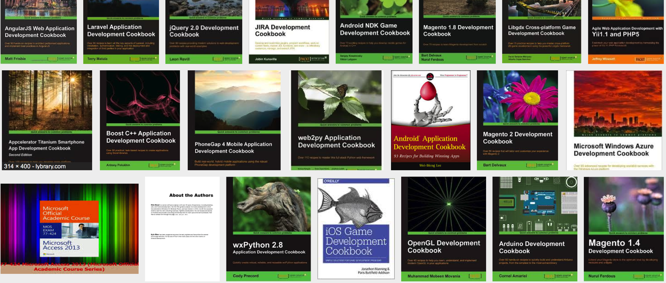
Cookbooks, anyone?
…
Dev- …
~ 400 and counting!*
…
* Big data frameworks alone have 1-3 cookbooks each and they grow almost by the week
Notes:
Do you want to know the numbers? Well there’s a study on the number of emerging terminologies and cookbooks in software engineering and at I hunch I isolated over 400 and mind you these increase with the release of each different framework or eve open-source community

Slide 24
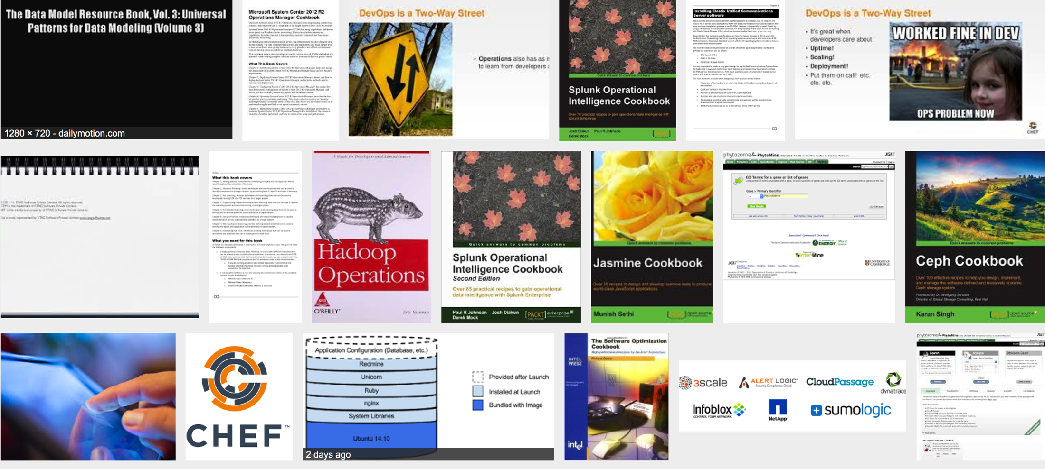
Cookbooks, anyone?
-Ops…
…
200-300 and counting!*
…
*DevOps trends and infrastructure-as-code are driving the increase!
Notes:
And the same goes with operations as well…

Slide 25
DevOps: Putting it all together
The motivation for DevOps is that developers and operators often have opposing goals:
On one hand, Developers (Devs) try to push new features into the product;
On the other hand, the core concern of operators (Ops) is quality — i.e., high burdens on releasing features
The goal of DevOps is baking with practices that achieve both at high frequencies via collaboration, community, and sharing between Devs and Ops*
* Paraphrased from [1]
Notes:
So… putting it all together, where does this leave us?
DevOps essentially emerges as a series of organisational, social, socio-technical and technical strategies to blend together developers and operators in such a way so as to allow their seamless interoperation and cooperation... Where once developers focused on systems features and operators pushed for quality to the customers, DevOps promises to achieve both, at high speeds by encouraging community and sharing...

Slide 26
Hey… wait a second...
What about the kitchen?
Notes:
So at this point… you may and should still be asking yourself, wait a second... There’s a kitchen missing...

Slide 27
DevOps: Putting it all together… where’s the kitchen?
The motivation for DevOps is that developers and operators often have opposing goals:
On one hand, Developers (Devs) try to push new features into the product;
On the other hand, the core concern of operators (Ops) is quality — i.e., high burdens on releasing features
The goal of DevOps is baking with practices that achieve both at high frequencies via collaboration, community, and sharing between Devs and Ops*
Here’s the Kitchen!
Notes:
No there’s not… you had it. It was right there under our nose....

Slide 28
DevOps Practices: Let’s take a look
Acceleration Tactics
Use Faster Organization: Merge Dev+Ops Teams
Infrastructure-as-Code
Use Continuous Integration
Use Continuous Deployment
Use Continuous Testing
Use Continuous Architecting
Waste Reduction Tactics
Canary Testing
A/B Testing
Reduce Documentation
Minimalistic Architecting ➔ Microservices

Slide 29
DevOps Practices: Let’s take a look
Omniscience Tactics
Monitor Everything
Monitoring-as-a-service
On-The-Fly Risk Engineering
Omniscient Analytics

Slide 30
DevOps Practices: Let’s take a (deeper) look on a few of them!
Acceleration Tactics
Use Faster Organization: Merge Dev+Ops Teams
Infrastructure-as-Code
Use Continuous Integration
Use Continuous Deployment
Use Continuous Testing
Use Continuous Architecting
Waste Reduction Tactics
Canary Testing
A/B Testing
Reduce Documentation
Minimalistic Architecting ➔ Microservices

Slide 31
Dev & Ops: the classical roles
Dev focuses on
Developing features
Changing requirements
Releasing products
Ops focuses on
Offering services
Providing guarantees and stability

Slide 32
Dev vs. Ops
“The system works correctly in the development machine but it does not on the operation machine”
“10 days after successful deployment of last release, the system is overloaded”
Who is guilty? Dev– team, or –Ops team?

Slide 33
The problem: two disconnected groups
Dev works to apply releases
Dev does not pay attention to QoS guarantees
Ops resists to releases
Ops is aiming at guaranteering QoS
Changes are fundamental for the business!
QoS guarantees are needed too!

Slide 34
DevOps
What is it: “Practices or tools that bridge the gap between development and operations”
Goal: Creates a collaborative mindset where a single team performs Dev and Ops
→the team must contain differentiated competences, background, responsibilities, understanding, etc.
Requires:
Culture management;
Automation tools;
Organisational as much as technical metrics
Continuous sharing artifacts, procedures, languages, approaches…

Slide 35
DevOps Need 1: Process Alignment!
Unified Processes
Unified tooling
Before
DevOps
Development
IT Operations
Tools
Tools
Development
Test
Production
«Devs have to walk in Ops shoes and viceversa»
DevOps
QA – Quality Assurance
Development & IT Operations
Tools
Development
Test
Production
Collaborative Development
Continuous Testing
Continuous Monitoring

Slide 36
The four DevOps values
1
2
Development and test on production-like environment
Accelerated deploy using proper processes and tools
4
3
Continuous collaboration and feedback
Continuous validation of operation quality

Slide 37
IT performance and DevOps (1)
Main IT performance metrics
Throughput
Deployment frequency
Lead time for release
Stability & Quality
Mean time to recover from failure

Slide 38
Waterfall vs. Agile vs. DevOps
Concerns | Waterfall | Agile | DevOps
Main Focus | Design and development | Design and development | Whole application life-cycle
Attention to Operation | Minimal or none | Minimal or none | Main concern
Role of Maintenance | Maintenance seen as a redevelopment phase | Maintenance seen as a redevelopment phase | Replaces a running system with a running system
Process Outcome | A packaged system ready to be deployed | Various intermediate demo versions of the system | A continuously updated running system
Quality Assurance | Testing typically performed toward the end of the process | Test-driven development | Test-driven development and monitoring-driven operation with feedback to Dev

Slide 39
Who focuses on DevOps (in some way)?
2014 State of DevOps Report, Puppet Labs (9200+ respondents)

Slide 40
Puppet Labs Findings and Survey recommendations
Clear correlation between high IT performance and strong business performance
Suggestions for improvement:
 | Practitioners | Managers
Cross-functional collaboration | Work with other teams Find ways to build empathy Make invisible work visible | Build trust Encourage practitioners to move between departments Facilitate collaboration
Climate of learning | Learn by sharing knowledge Always bring back what you learned Prepare for postmortems | Create and acquire training budget Create a climate of learning and sharing Make it safe to fail
Tools | Automate the things that are painful | Make sure your team chooses the tools Make monitoring a priority

Slide 41
DevOps Re-Organization, Claimed general advantages
Shorten time-to-value
Quick and regular release of software features
Improve quality
Mitigate risks
Increase collaboration in the team

Slide 42
DevOps Organisational Changes
What to avoid: anti-patterns
Dev
Ops
Dev
DevOps
Ops
Separate Silos
Separate DevOps Silo
Dev
DevOps
Ops
We don’t need Ops
From M. Skelton. What Team Structure is Right for DevOps to Flourish? 2013 http://blog.matthewskelton.net/2013/10/22/what-team-structure-is-right-for-devops-to-flourish/
http://web.devopstopologies.com

Slide 43
DevOps Organisational Changes
What to do: typical adoption patterns
Dev
Ops
Dev
Ops
Dev
DevOps
Ops
Smooth collaboration
Fully Embedded
Infrastructure as a Service
Dev
DevOps
Ops
Dev
DevOps
Ops
DevOps as a Service
Temporary DevOps Team
From M. Skelton. What Team Structure is Right for DevOps to Flourish? 2013 http://blog.matthewskelton.net/2013/10/22/what-team-structure-is-right-for-devops-to-flourish/
http://web.devopstopologies.com

Slide 44
DevOps Practices: However...
[…]
Omniscience Tactics
Monitor Everything
Monitoring-as-a-service
On-The-Fly Risk Engineering
Omniscient Analytics
Most of them are research concepts or concept experiments in industry with the exception of three:
Infrastructure-as-code;
Microservices;
And…
<Moment-of-suspense>

Slide 45
DevOps Practices: Let’s take a look
Omniscience Tactics
Monitor Everything
Monitoring-as-a-service
On-The-Fly Risk Engineering
Omniscient Analytics
Most of them are research concepts or concept experiments in industry with the exception of three:
Infrastructure-as-code; ✓
Microservices; ✓
Continuous Architecting ☺

Slide 46
Continuous Architecting Explained
Software Architecture responds to architecture drivers... Upgrade the drivers for DevOps!
Design for Modifiability
Design for Observability
Design for Evolution & Testability
Design for Availability & Performance, but… most of all…

Slide 47
Continuous Architecting Explained
Software Architecture responds to architecture drivers... Upgrade the drivers for DevOps!
Design for Modifiability
Design for Observability
Design for Evolution & Testability
Design for Availability & Performance, but… most of all…
Design for SA failure!
SA is incremental, refined from a rough draft via neverending continuous architectural improvement!

Slide 48
Continuous Architecting Explained
Dev Goal: “Prepare a Software Architecture designed to be immediately deployable”
Ops Goal: “Observe the architecture runtime and provide Ops feedback to Dev…then improve architecture continously”

Slide 49
Continuous Architecting Explained
Software Architecture responds to architecture drivers... Upgrade the drivers for DevOps!
Design for Modifiability
Design for Observability
Design for Evolution & Testability
Design for Availability & Performance, but… most of all…
Design for failure and incremental, continuous architectural improvement
Design for a specific Organizational Structure

Slide 50
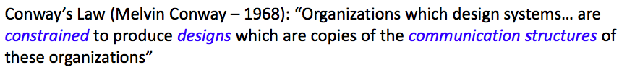
Continuous Architecting Explained*
Design for a specific Organizational Structure!
The organization of your teams has an impact on your system designs… Make it explicit into your design!
This is where microservices help ➔ Leverage the small!
Remove burdens and barriers from the organization as you would in the architecture, remember Conway’s Law:
* “Continuous Architecting” by © Pierre Pureur & Murat Erder

Slide 51
DevOps: Let’s take a step back... the kitchen!
The motivation for DevOps is that developers and operators often have opposing goals:
On one hand, Developers (Devs) try to push new features into the product;
On the other hand, the core concern of operators (Ops) is quality — i.e., high burdens on releasing features
The goal of DevOps is baking to achieve both at high frequencies by encouraging collaboration, community and sharing between Devs and Ops
Here’s the kitchen!
Organizational Structures for DevOps Software Engineering! [4]
Notes:
And it also has a name!!!

Slide 52
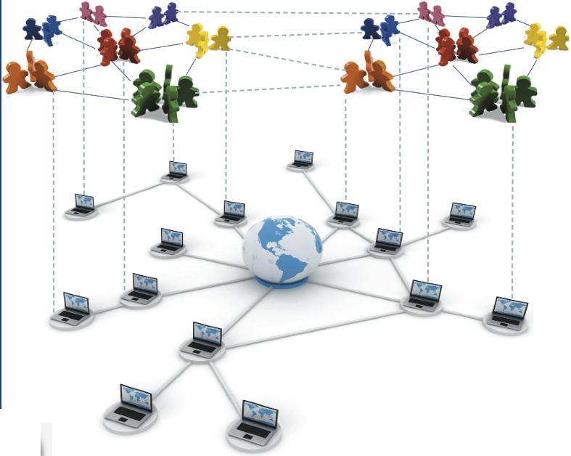
More about the kitchen… Organizational Structures explained
“the graph of interactions, patterned relations and arrangements emerging between individuals in the same endeavor”...
So, a graph of:
Software People (devs., ops., etc.)
Software Things (Code, Architecture, VCSs, blogs, etc.)
Their Relations (Org., Soc., Tech.)
The Emergent Properties of the structure (recurrence, effectiveness, health, stability, etc.) [4,5]
Notes:
And it has a very nice and elaborate definition – I spent my entire Ph.D. contemplating it in relation to a large number of organisational and social phenomena rotating around it and influencing negatively as well as positively the software engineering organizational structure

Slide 53
More about the kitchen…
“the graph of interactions, patterned relations and arrangements emerging between individuals in the same endeavor”...
So, a graph of:
Software People (devs., ops., etc.)
Software Things (Code, Architecture, VCSs, blogs, etc.)
Their Relations (Org., Soc., Tech.)
The Emergent Properties of the structure (recurrence, effectiveness, health, stability, etc.) [4,5]
New Customer
Would-be Customer
Regular Customer
Developer
Operator
Notes:
The relation is quite obvious… a number of different people, set to work

Slide 54
More about the kitchen…
“the graph of interactions, patterned relations and arrangements emerging between individuals in the same endeavor”...
So, a graph of:
Software People (devs., ops., etc.)
Software Things (Code, Architecture, VCSs, blogs, etc.)
Their Relations (Org., Soc., Tech.)
The Emergent Properties of the structure (recurrence, effectiveness, health, stability, etc.) [4,5]
Dev Cookbook
Here’s your opposite tastes!
Cognitive Distance
Ops Cookbook
Notes:
With several different languages.. Oh and there’s your opposite cookbook tastes – it has a name too in organizations research, i.e., cognitive distance or better the distance in cognition over the same artefact or scenario, this comes from the Netherlands as well under prof. Bart Nooteboom from Tilburg

Slide 55
More about the kitchen… what does it look like*?
Art. 1
Art. 3
Art. 2
Task Allocations
Art. N
Dev. 2
Dev. 3
Dev. 1
…
Dev. N-1
Art. 4
Dev. 4
Dev. N
Ops. 1
Collaboration Links
Ops. 3
Ops. 4
Ops. 2
*an annotated (socio-technical) graph with (a ton of) (interesting) properties… (Yay!)
Notes:
Now, more about the kitchen, what does it look like? Spoilers, it’s a graph… good news!! It means we can study it

Slide 56
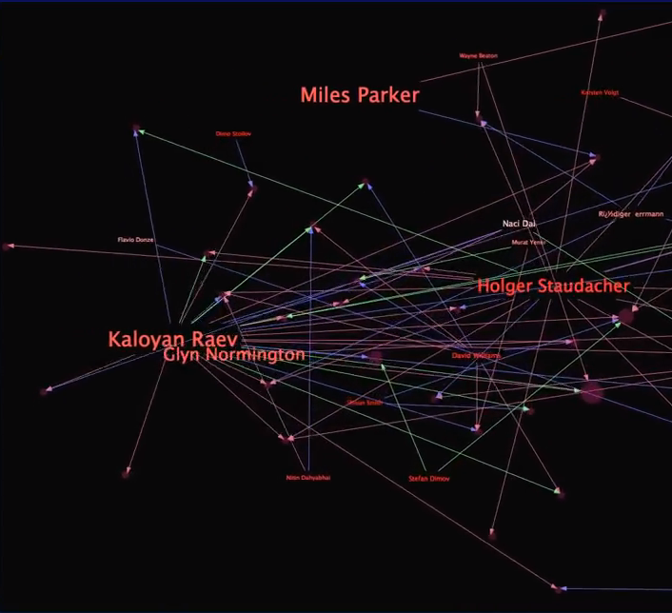
More about the kitchen… where is it?
Mine data from task databases
Build a social network
Mine data from task databases (JIRA, BugZilla, etc.)
Build a social network
For Example... Eclipse MyLyn
Spring Task DB
SpringSource Task DB
Eclipse Bugzilla
...
Notes:
Or can we? Where do we dig to elicit it?

Slide 57
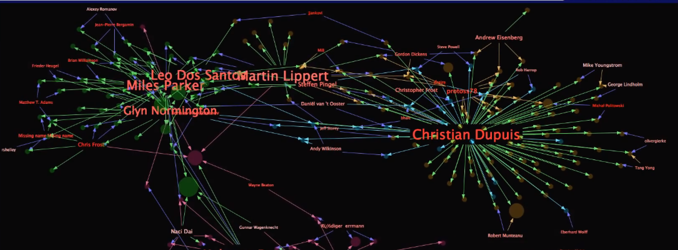
You add some SNA and you get something like this...
Behold…
MyLyn!!!!

Slide 58
… And / Or this!!!
Community structure 1
Community
Structure 2
Latent Community 3: ???

Slide 59
More about the kitchen, what do we look for? Patterns! For example...
Comm. 1
Correct Boundary-spanning practices across Dev- and -Ops communities
Comm. 3
Notes:
Less than half of the people in either org., then you’re asking for trouble

Slide 60
In conclusion… what do we do now about that kitchen?
One single message:
Effective DevOps means mature “kitchens”, a.k.a., mature organizational structures before it delivers!

Slide 61
In conclusion… what do we do now about that kitchen?
One single conclusion:
Effective DevOps means mature “kitchens”, a.k.a., mature organizational structures before it delivers!
Characterize DevOps organisational structures
Find empirical DevOps organisational patterns [1]
Put together and manage DevOps-ready software architectures [2,3]
Tackle DevOps Architectures’ Technical and Social Debts [3,4,5]
…

Slide 62
Our Previous Work in Social Software Engineering: Technical vs. Social Debt
Technical debt “features”:
Not all technical debt is bad
It can be measured, managed/avoided or turned into acceptable loss
It is just one face of the coin we call Conway’s law:
“software design mirrors the structure of the organization that builds it”
Social Debt
Technical Debt
SOFTWARE ARCHITECTURE
ORG.-SOC. STRUCTURE

Slide 63
In summary: Continuous Architecting
Software Architecture responds to architecture drivers... Upgrade the drivers for DevOps!
Design for Modifiability
Design for Evolution & Testability
Design for Availability & Performance, but… most of all…
Design for failure and incremental, continuous architectural improvement
Design for a specific Organizational Structure
Remember...
Continuous architecture is (like MDA) a style of architecting rather than a style of architecture

Slide 64
DevOps processes and toolchain: Putting it all together...
- Continuous Architecting
Def. “architect for test, build and deploy, take quality attributes into account, take advantage of feedback from runtime” [1]
- Continuous Integration
Def. “merge all developer work-copies to a shared mainline frequently” [4]
Examples. Apache Jenkins, Hudson, etc.
- Continuous Testing
Def. “run tests as part the build pipeline so that every check-in and deployment is validated” [3]
Examples. Selenium+GitHub+LI-API, etc.
…
Image by Kharnagy (Own work) [CC BY-SA 4.0 (http://creativecommons.org/licenses/by-sa/4.0)], via Wikimedia Commons

Slide 65
DevOps processes and toolchain: Putting it all together...
- Continuous Architecting
Def. “architect for test, build and deploy, take quality attributes into account, take advantage of feedback from runtime” [1]
- Continuous Integration
Def. “merge all developer work-copies to a shared mainline frequently” [4]
Examples. Apache Jenkins, Hudson, etc.
- Continuous Testing
Def. “run tests as part the build pipeline so that every check-in and deployment is validated” [3]
Examples. Selenium+GitHub+LI-API, etc.
…
Image by Kharnagy (Own work) [CC BY-SA 4.0 (http://creativecommons.org/licenses/by-sa/4.0)], via Wikimedia Commons

Slide 66
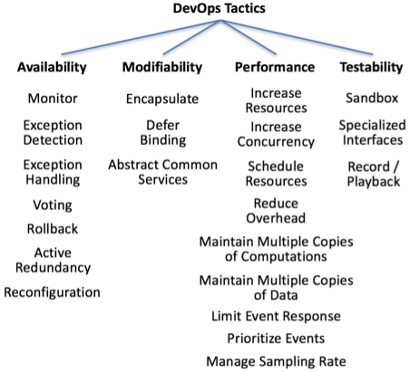
In summary, new architecture drivers for Continuous Architecting*
Chen, et al. "Architectural Support for DevOps in a Neo-Metropolis BDaaS Platform.." Paper presented at the meeting of the SRDS Workshop, 2015.

Slide 67
Conclusions (1)
DevOps is concerning all typical software architecture dimensions (team, process, tooling)
Differently from other approaches, it focuses on two subject
The application code (the software)
The code to create, run, control, evolve the machine
TOSCA (previously seen) is an attempt to standardize infrastructural code

Slide 68
Conclusions (2)
What we miss, architecturally:
A better connection between the design of software and the design of the infrastructure
A precise and rigorous comparison between the new languages and tools for coding infrastructures

Slide 69
References
[1] Erder, Murat and Pureur, Pierre. Continuous Architecture: Sustainable Architecture in an Agile and Cloud-Centric World. Amsterdam: Morgan Kaufmann, 2016.
[2] Continuous Testing Paperback – January 2, 2014 by W. Ariola, C. Dunlop
[3] Part of the Pipeline: Why Continuous Testing Is Essential, by Adam Auerbach, TechWell Insights August 2015
[4] M. Fowler Continuous Integration, https://www.thoughtworks.com/continuous-integration
[5] Chen, Lianping (2015) "Continuous Delivery: Huge Benefits, but Challenges Too” IEEE Software. 32 (2): 50.
[6] http://docs.oasis-open.org/tosca/TOSCA-Simple-Profile-YAML/v1.0/csd03/TOSCA-Simple-Profile-YAML-v1.0-csd03.html
[7] P. Lipton, D. Palma, M. Rutkowski, and D. A. Tamburri, “Tosca solves big problems in the cloud and beyond!” IEEE Cloud, vol. 21, no. 11, pp. 31–39, 2016.
[8] Guerriero, Michele, Tajfar, Saeed, Tamburri, Damian Andrew and Di Nitto, Elisabetta "Towards a model-driven design tool for big data architectures.." Paper presented at the meeting of the BIGDSE@ICSE, 2016.
[9] Gómez, Abel, Merseguer, José, Di Nitto, Elisabetta and Tamburri, Damian Andrew. "Towards a UML profile for data intensive applications.." Paper presented at the meeting of the QUDOS@ISSTA, 2016.
[10] Artac, Matej, Borovsak, Tadej, Di Nitto, Elisabetta, Guerriero, Michele and Tamburri, Damian Andrew. "Model-driven continuous deployment for quality DevOps.." Paper presented at the meeting of the QUDOS@ISSTA, 2016.

Slide 70
Other Biblio
[1] Bass, L. J.; Weber, I. M. & Zhu, L. (2015), DevOps - A Software Architect's Perspective. , Addison-Wesley .
[2] Tamburri, D. A. & Nitto, E. D. (2015), When Software Architecture Leads to Social Debt., in Len Bass; Patricia Lago & Philippe Kruchten, ed., 'WICSA' , IEEE Computer Society, pp. 61-64 .
[3] Tamburri, D. A.; Kruchten, P.; Lago, P. & van Vliet, H. (2015), 'Social debt in software engineering: insights from industry.', J. Internet Services and Applications 6 (1) , 10:1-10:17 .
[4] Tamburri, D. A.; Lago, P. & van Vliet, H. (2013), 'Organizational social structures for software engineering.', ACM Comput. Surv. 46 (1) , 3 .
[5] Tamburri, D. A.; Lago, P. & van Vliet, H. (2013), 'Uncovering Latent Social Communities in Software Development.', IEEE Software 30 (1) , 29-36 .
[6] M. Di Penta, D. A. Tamburri, Combining Quantitative and Qualitative Methods in Empirical Software Engineering Proceedings of the 10th Joint Meeting of the European Software Engineering Conference and the ACM Sigsoft Symposium of the Foundations of Software

